Slide 1
Item Sales Predictions

Slide 2
Data Dictionary
Item_Identifier: Unique product ID
Item_Weight: Weight of product
Item_Fat_Content: Whether the product is low or regular in fat content
Item_Visibility: The percentage of total display area of all products in a store allocated to the particular product
Item_Type: The category to which the product belongs
Item_MRP: Maximum Retail Price (list price) of the product
Outlet_Identifier: Unique store ID
Outlet_Establishment_Year: The year in which the store was established
Outlet_Size: The size of the store in terms of ground area covered
Outlet_Location_Type: The type of area in which the store is located
Outlet_Type: Whether the outlet is a grocery store or some sort of supermarket
Item_Outlet_Sales: Sales of the product in the particular store. This will be the target variable to be predicted.

Slide 3
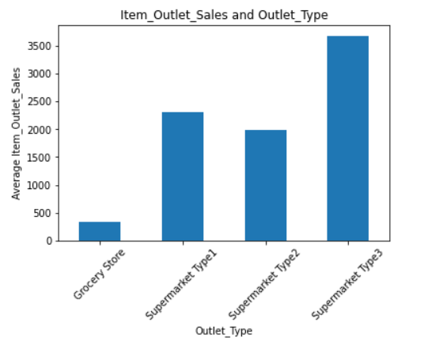
Cleaning the Data
As expected, Two columns, Item_Weight and Outlet_Size had missing values. Both had a large number of missing values, so the rows were not dropped; what instead was done was that values were imputed by using an interpolation method for both columns.
For the Outlet_Size column, the data was sorted in order of Item_Outlet_Sales before backfilling missing values because there was a clear relationship between average item_Outlet_Sales and the Outlet_Type.

Slide 4
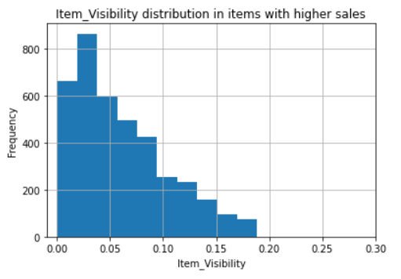
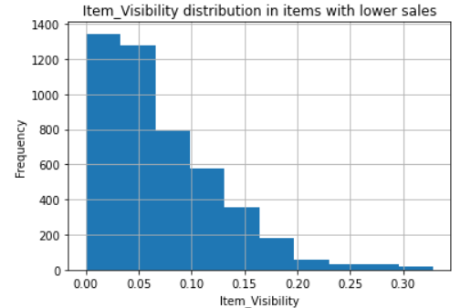
Exploring the Data
When exploring the data, I was attempting to find where the strongest relationships were. To do this, one method that was used was the separation of the data into two subsections, one with a high Item_Outlet_Sales and another with a low Item_Outlet_Sales, these filters were then used to try to find different distributions within other features when looking at rows with low sales versus high sales.

Slide 5
Machine Learning
Set up the data - Columns with discrete values were turned into numerical data columns - One Hot Encoding method was utilized - Split the data into a training and a testing data set (75:25 split) - The target vector was the Item_Outlet_Sales column - Fit and transform data for the KNN model (not random forest)
After all these steps were successfully conducted, an instance of the models could be created and fit on the training data.

Slide 6
Models
Two different types of models were used, K-Nearest-Neighbors for regression and Random Forest for regression. In both cases for the models, the number of neighbors/estimators was optimized by testing many different values in a range and finding what value gives the lowest Root Mean Squared Error (RMSE). The two models, KNN and random forests, had overall similar RMSEs but the random forest beat out KNN by a difference in RMSE of around 40.

Slide 7
Recommendations
Based on the importances of some features, here are some recommendations on how to maximize Item_Outlet_Sales:
Grocery Store types usually sell a lower amount of items, which leads to them having lower Item_Outlet_Sales in general, therefore if your goal is to increase the total amount of Item_Outlet_Sales, Grocery Stores are not where your items should be sold (or the item should be sold at more locations).
Opposite to above, Supermarket Type3 has a relationship of increasing Item_Outlet_Sales in general. A recommendation if the goal is to maximize Item_Outlet_Sales is to sell items in a Supermarket Type3.
Another feature with a positive correlation to Item_Outlet_Sales is Item_MRP, this might suggest that increasing Item_MRP might lead to higher item sales; this makes some sense because it does not mean that the actual price of the item will increase, but rather that the maximum price that the outlet can charge will increase, which can lead to a more flexible choosing of the price, which might lead to a better estimation of the equilibrium price.

